Slide 1
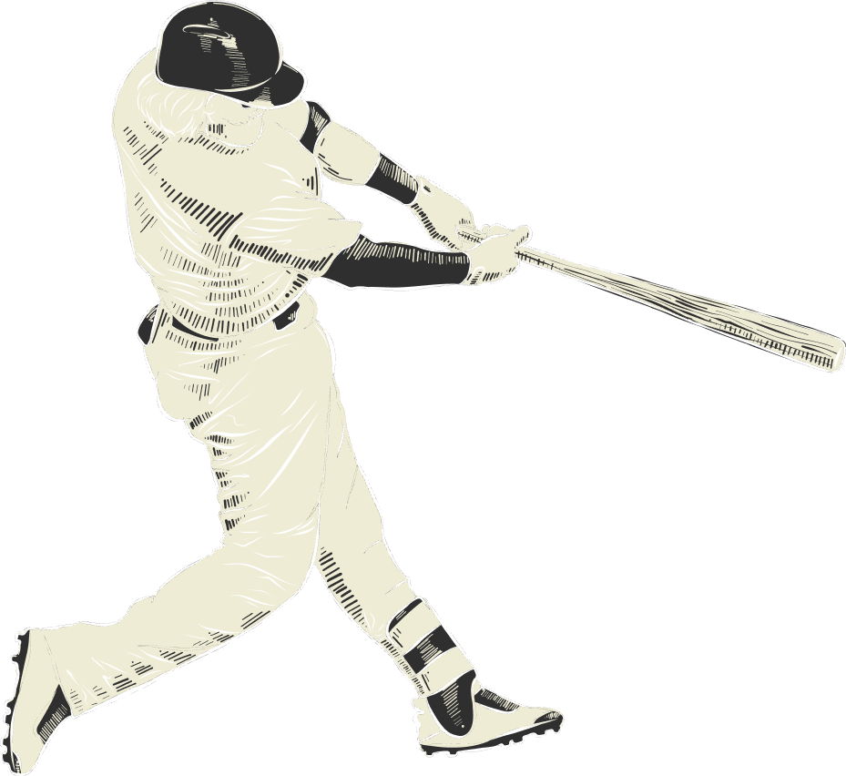
Weekly Updates
sdmay25-11

Slide 2
Last Week
Upcoming
01
Training
01
Final Additions
.pt, .tflite, .mlmodel
Flutter Screen Development
02
Testing
02
Testing
ISU Softball Fields
App Testing / User Testing
03
Documentation
Final Design Document
Appendices
Poster

Slide 3
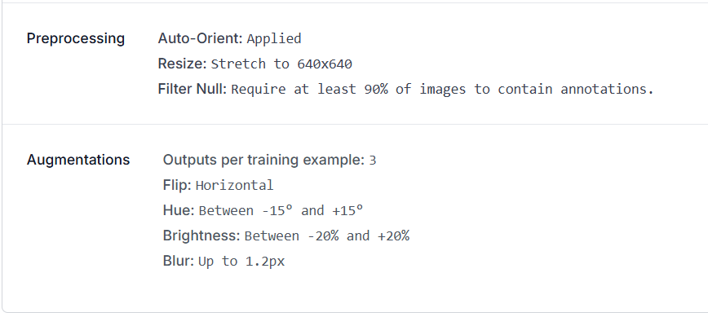
Training
Trained a PyTorch model on Roboflow data.
Converted to TensorFlow Lite with TensorFlow’s Docker dependency container
In total, the model includes 11,110 images with the shown preprocessing and augmentation steps
Model is included into the Ultralytics Plugin with a result stream to update ball coordinates.

Slide 4
Testing
Went out on Thursday to test the model on the ISU softball fields.
Broad daylight
Camera placed against fence with tripod
Balls were detected along the pitching line and coordinates were updated.
During testing, the orientation of iPhone devices limited our ability to test.
There were some inconsistencies in how Flutter and the Ultralytics Plugin handled orientation when the device was horizontal.
Model was operating continuously around 30fps

Slide 5
Upcoming Course Plans
Development → Testing → Documentation/Poster
1 week
1 week
2 weeks
Final Poster: Due May 4th
Final Design Document: Due May 4th

Slide 6
Final Additions
Pitcher’s Bounding Box
Instruction Video
Linking Audio
Using the coordinates of the pitchers mound, we can create a visual bounding box around the pitcher.
Used later in “arming” the application for pitches
Create instructional video for navigating the app and setting up the camera
Include on YouTube or within a video player in the app.
Linking the “Illegal” audio to when an illegal height is calculated.

Slide 7
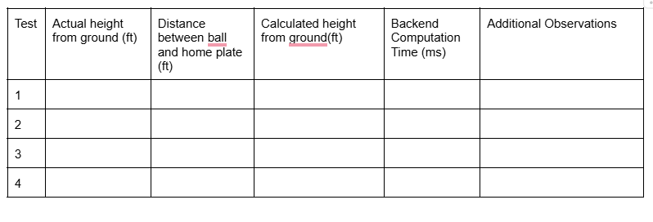
Testing
One week will be allocated for testing recorded heights/fps against known heights and testing the user experience.
All data will be formally recorded and performed using the our testing templates.
Testing analysis will be included within the testing document.
Testing Document

Slide 8
Final Design Document
01
Design Document
Appendix 1 - Operation Manual
02
System Requirements
Design
Project Plan
Implementation Details
Testing
Broader Context
Installment Guide (Android / iOS)
User Interface Walkthrough
Setup Troubleshooting
03
Appendix 2 - Alternate Designs
04
Appendix 3 - Code
Talk about designs that were removed
OpenCV
C++ Backend
KCF Tracking
Project Structure
Important code snippets
Ultralytics Plugin
Height Calculation
Illegal Handling

